Slide 1
Neolithic Information Seeking
Marcia J. Bates, Ph.D.
Professor Emerita
Dept. of Information Studies
University of California, Los Angeles (UCLA)
mjbates@ucla.edu
https://pages.gseis.ucla.edu/faculty/bates/
Twitter: @mjbinfo

Slide 2
Neolithic Information Seeking
Designing online information systems for our inner hunter-gatherer

Slide 3
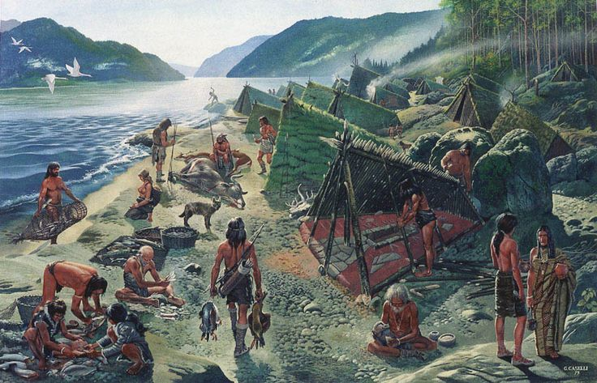

Slide 4
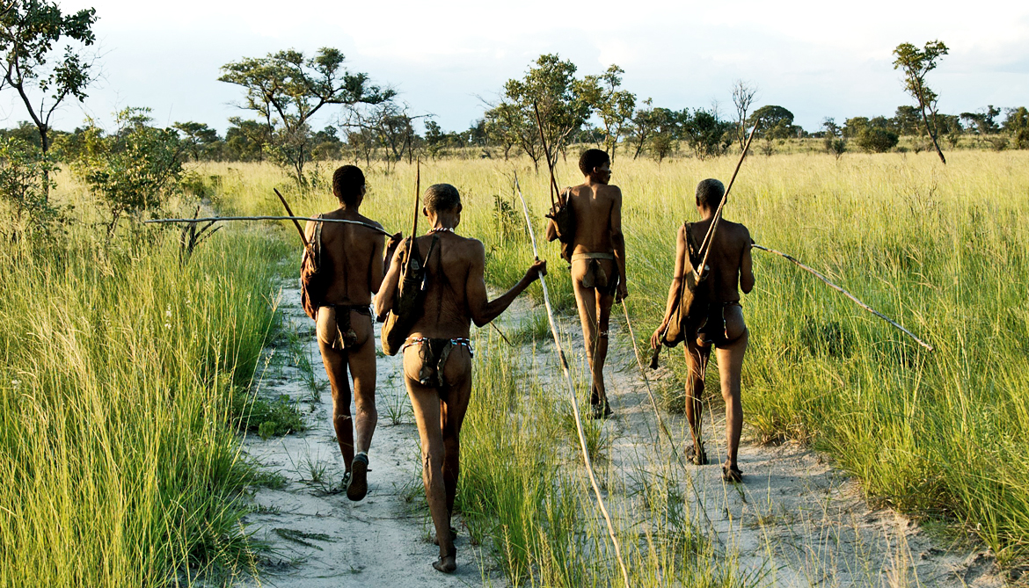

Slide 5
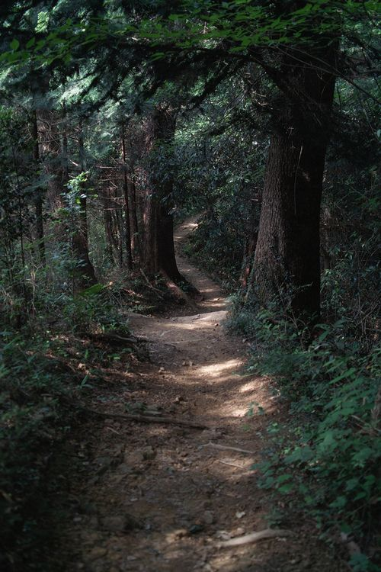

Slide 6
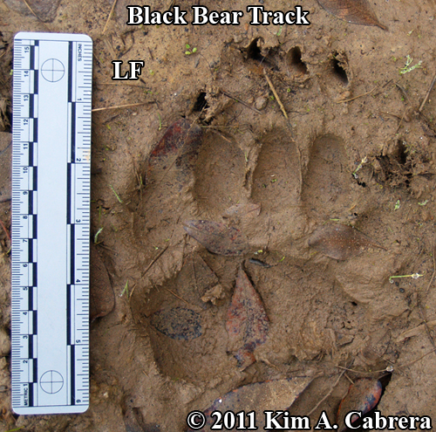

Slide 7
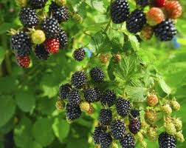

Slide 8
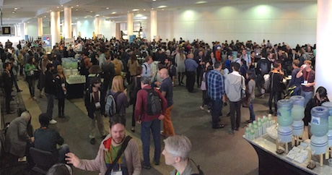

Slide 9
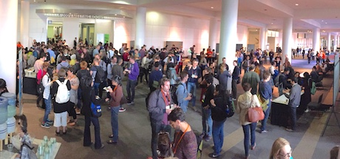

Slide 18
Both Neolithic Glorg and modern-day G.L. Org are using the
same fundamental capabilities and inclinations. They are
both looking to enhance their survival in a competitive and
ever-changing world.
These modes of coping with an unpredictable world are very
deeply embedded in our behaviors, and are the first that we
resort to when exploring generally or when needing some
particular information.

Slide 20
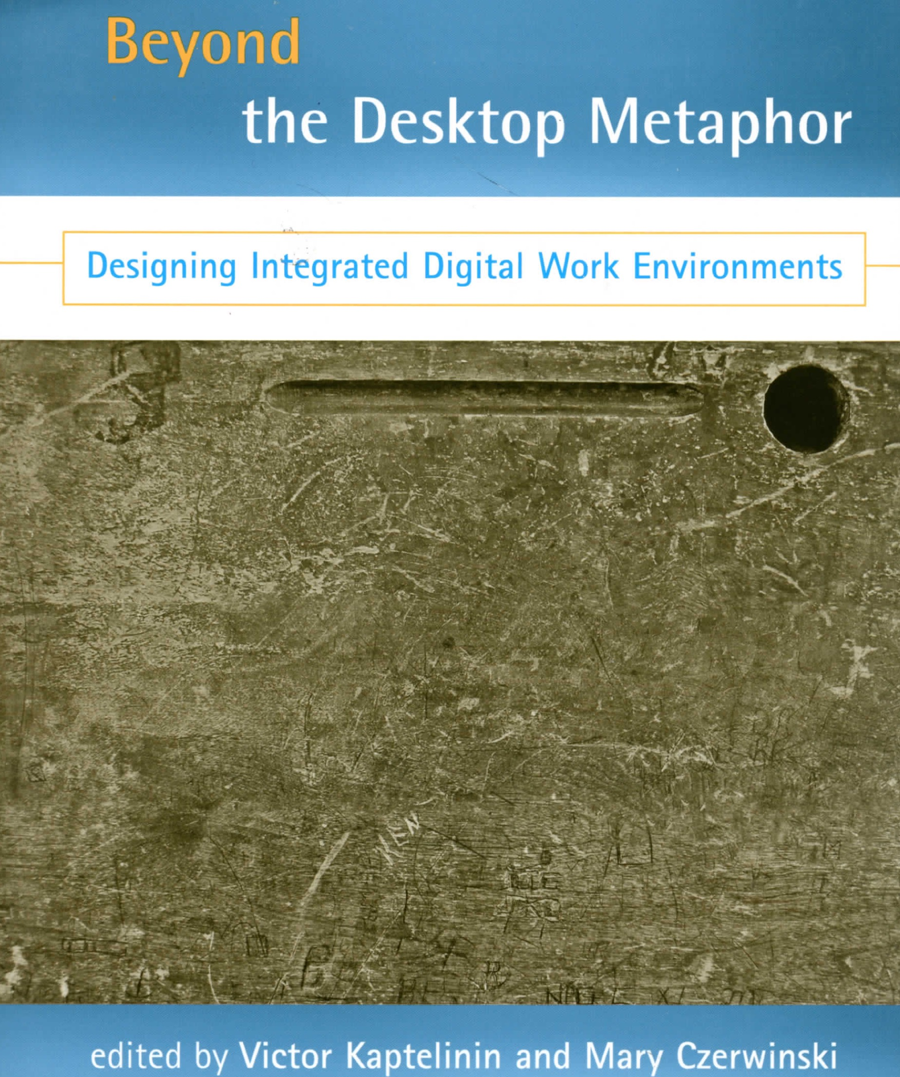

Slide 22
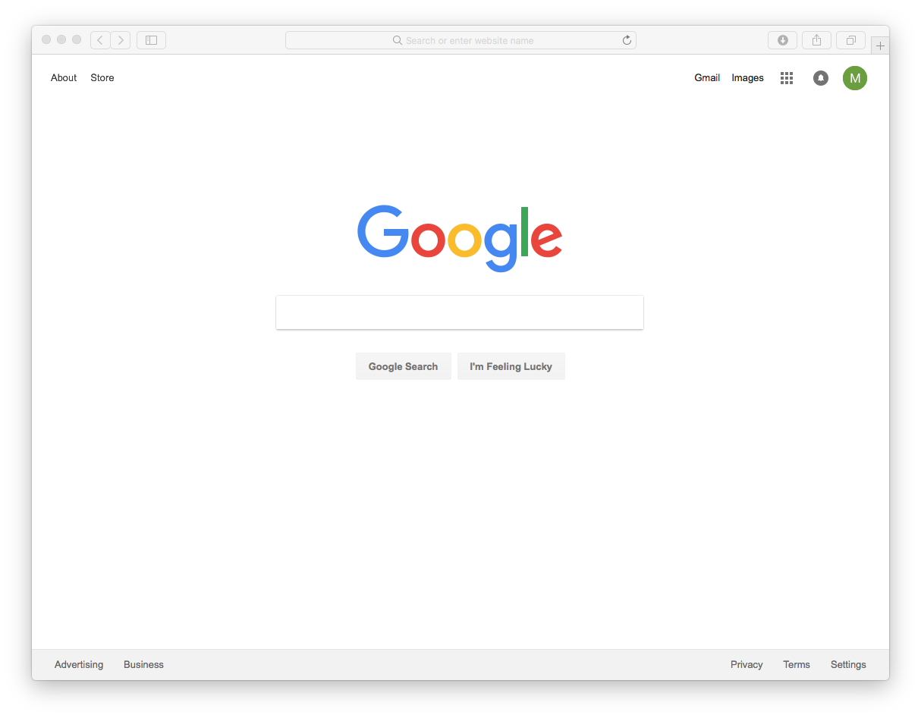

Slide 23
Wallpapering
Much information is gained through implicit
absorption, which I call “wallpapering.” In other
words, the information is in the environment one
is immersed in, and one picks it up inattentively,
but effectively.

Slide 24
Common forms of information acquisition besides active search
• “Running across” wanted information accidentally or serendipitously.
• “Running across” “unrelated” information that we suddenly recognize as relevant.
• “Noodling around” by casually examining informative materials without a purpose.
• “Keeping an eye out” for certain information, but not actively searching for it.
• “Monitoring” continuous streams of information that often prove productive.

Slide 25
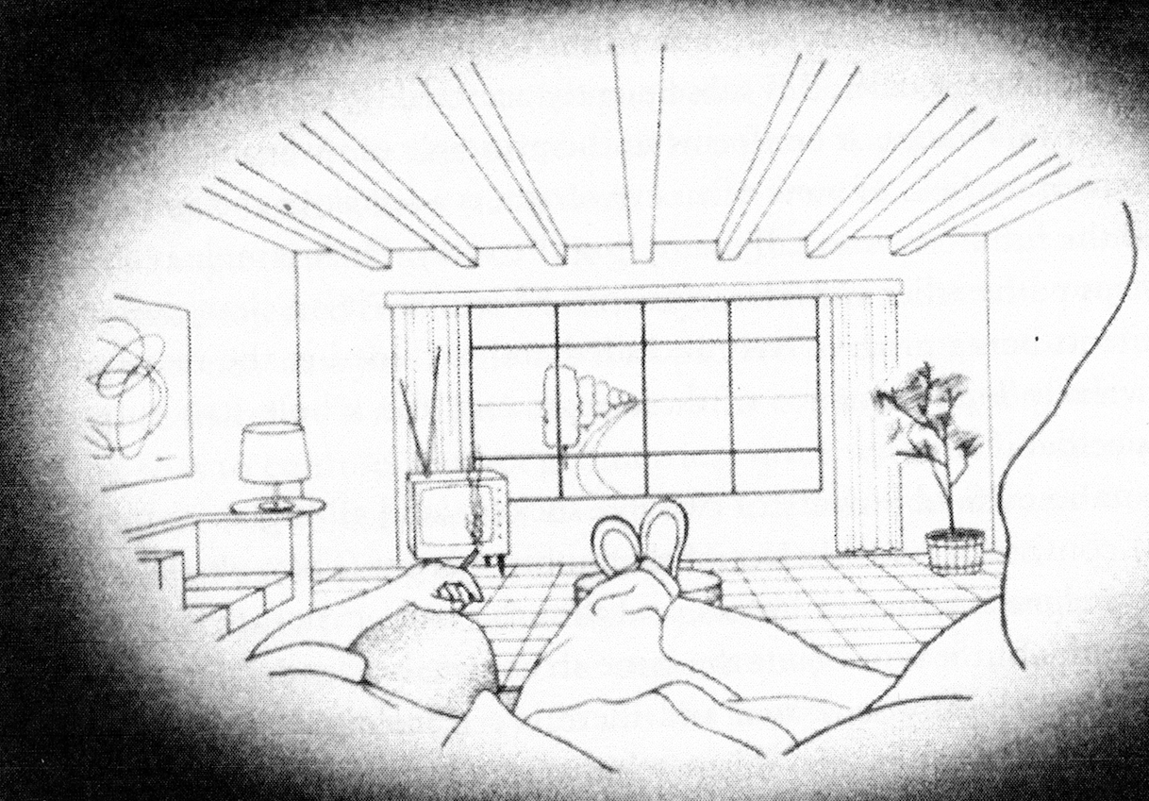

Slide 27
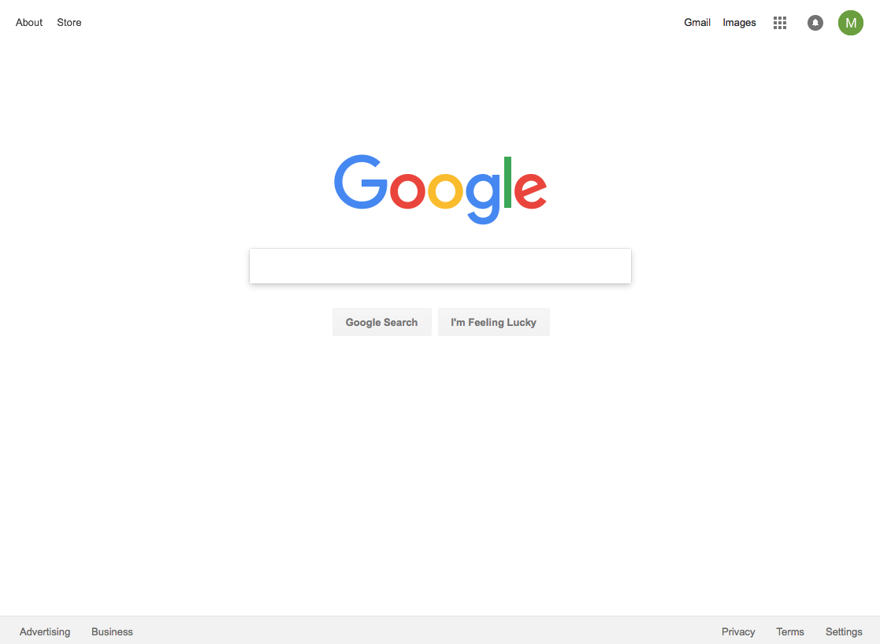

Slide 30
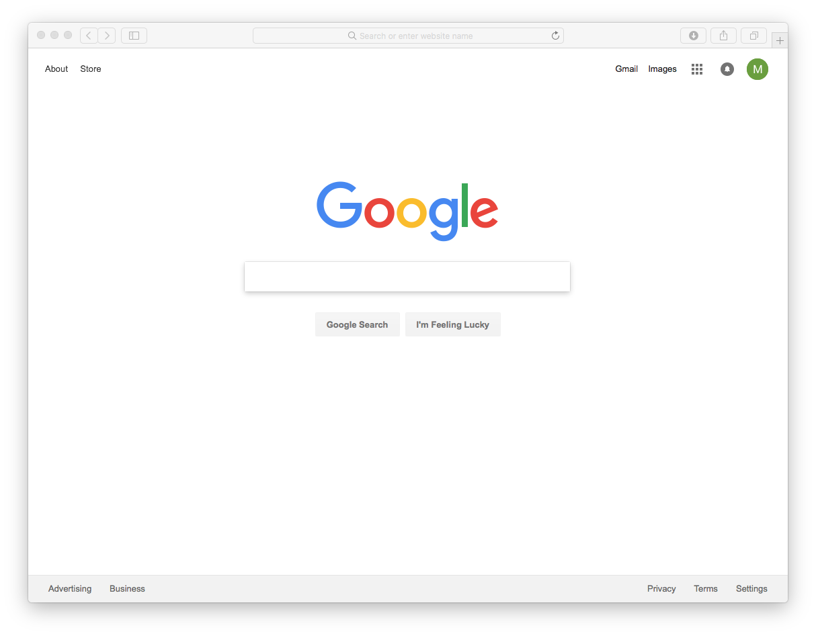

Slide 34
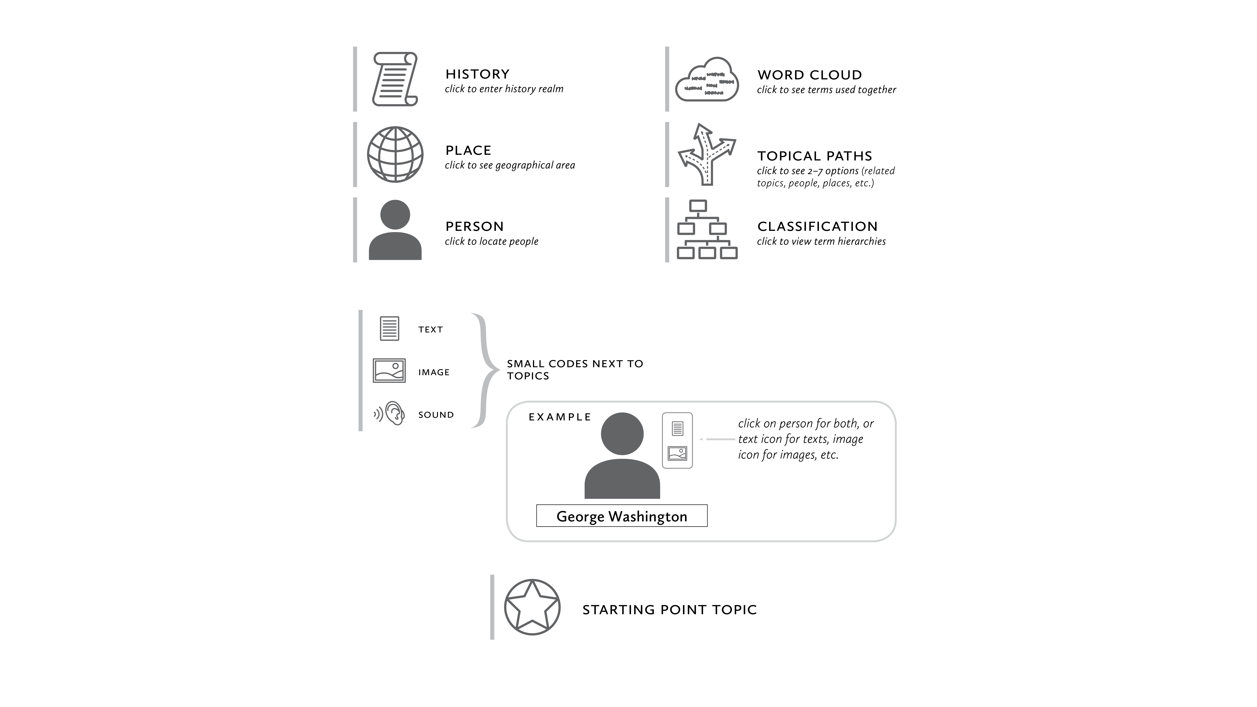

Slide 35
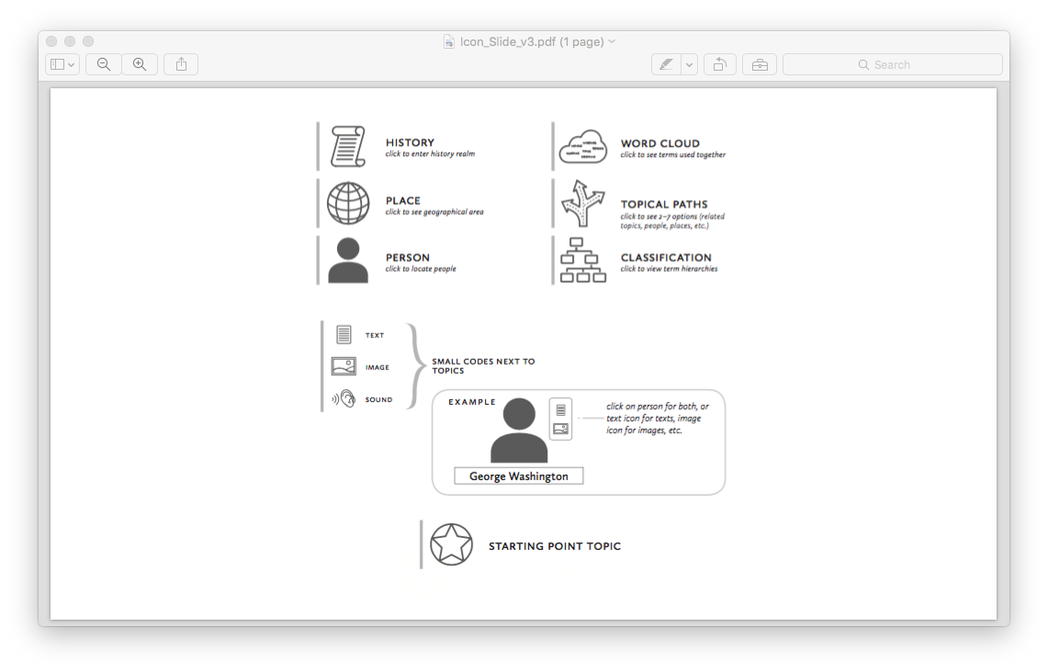

Slide 42
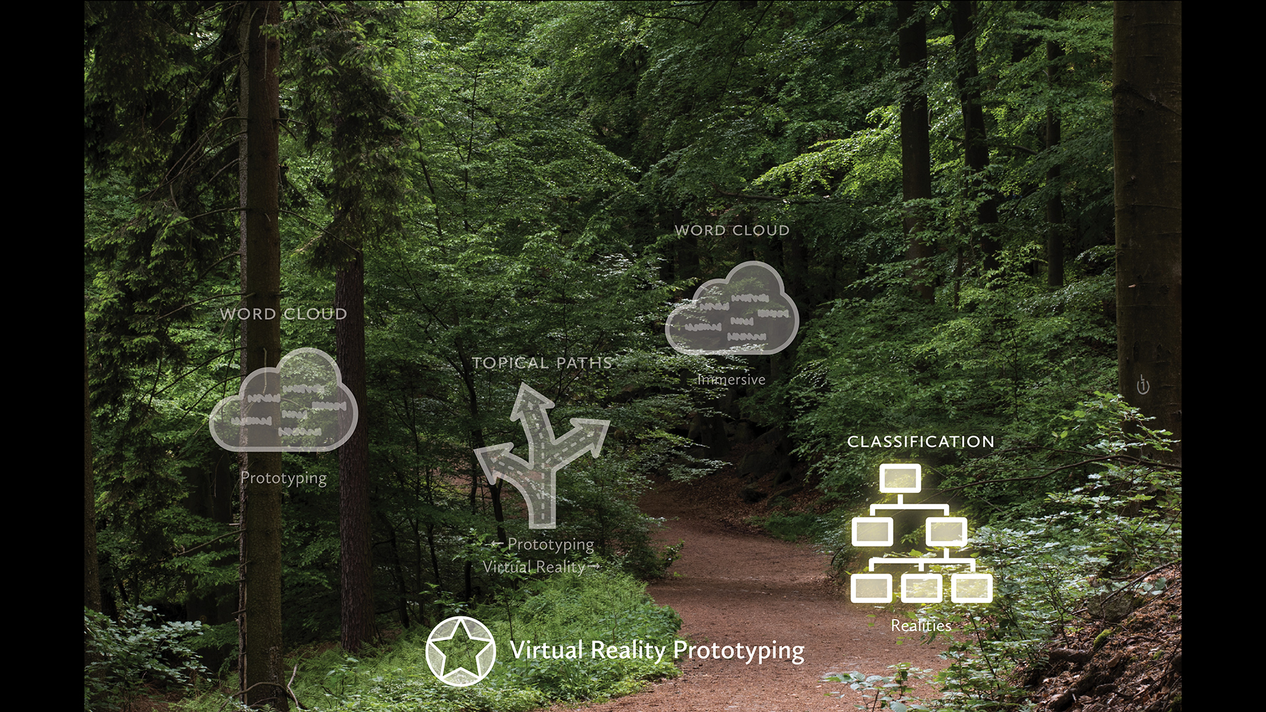

Slide 43
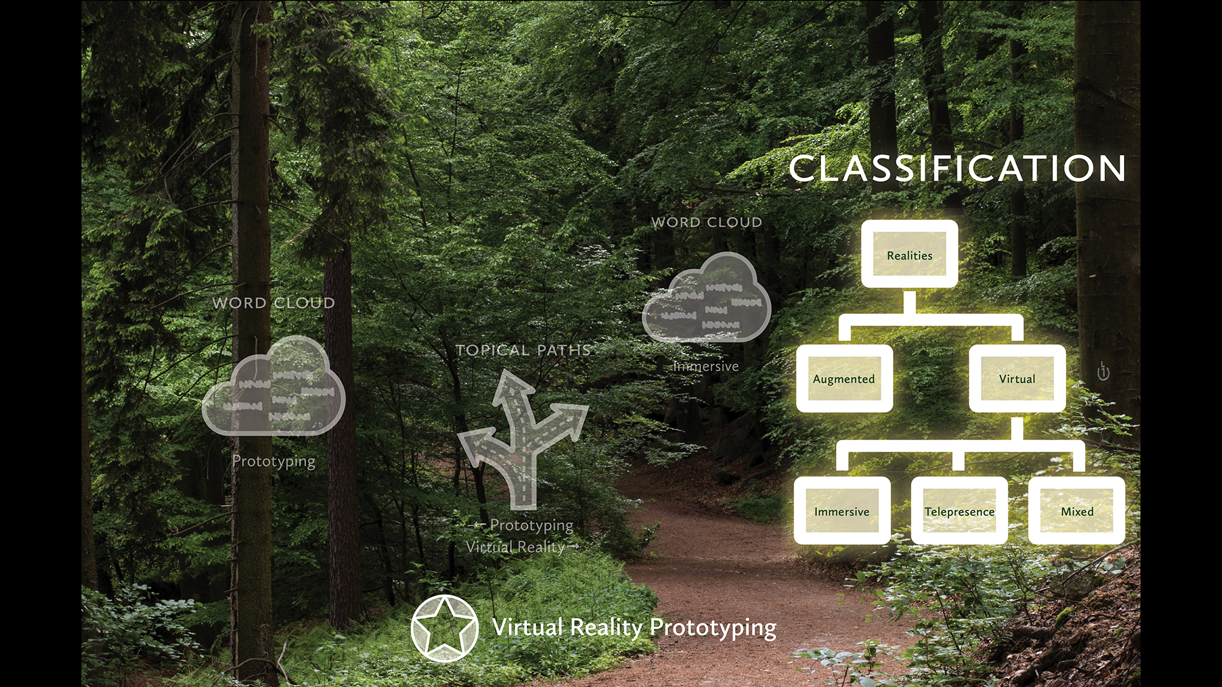

Slide 44
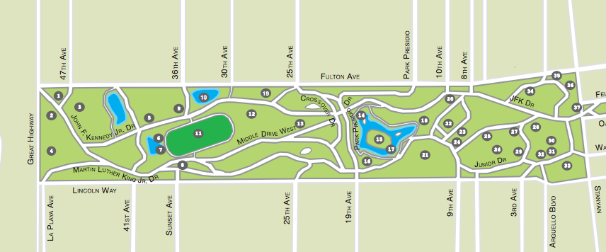

Slide 45
Command vs. Immersive Searching
Command searching: Ordering the system to get information on
the topic you name.
Immersive searching: “Moving-through-life” searching,
immersed in an information-rich world, with ingeniously
designed paths to explore, learn, and extract information.
Ideally, moving through this environment would enable one to
meet one’s actual needs, even if unarticulated.

Slide 46
Remaining Points
• Design for true browsing, not scanning
• Design for natural docking process
• Handling simple vs. complex questions
• Matching search mode to density of information in the landscape

Slide 48
How We Browse
• Acquire a field of vision.
• Notice something within it that interests us.
• Pick it up, and/or view it more closely.
• Keep the object or idea, or abandon it, then move on.
Bates, Marcia J. (2016). What is browsing—really? A model drawin from behavioural science
research. Information Research, 12(4) paper 330. http://InformationR.net/ir/12-4/paper330.html

Slide 50
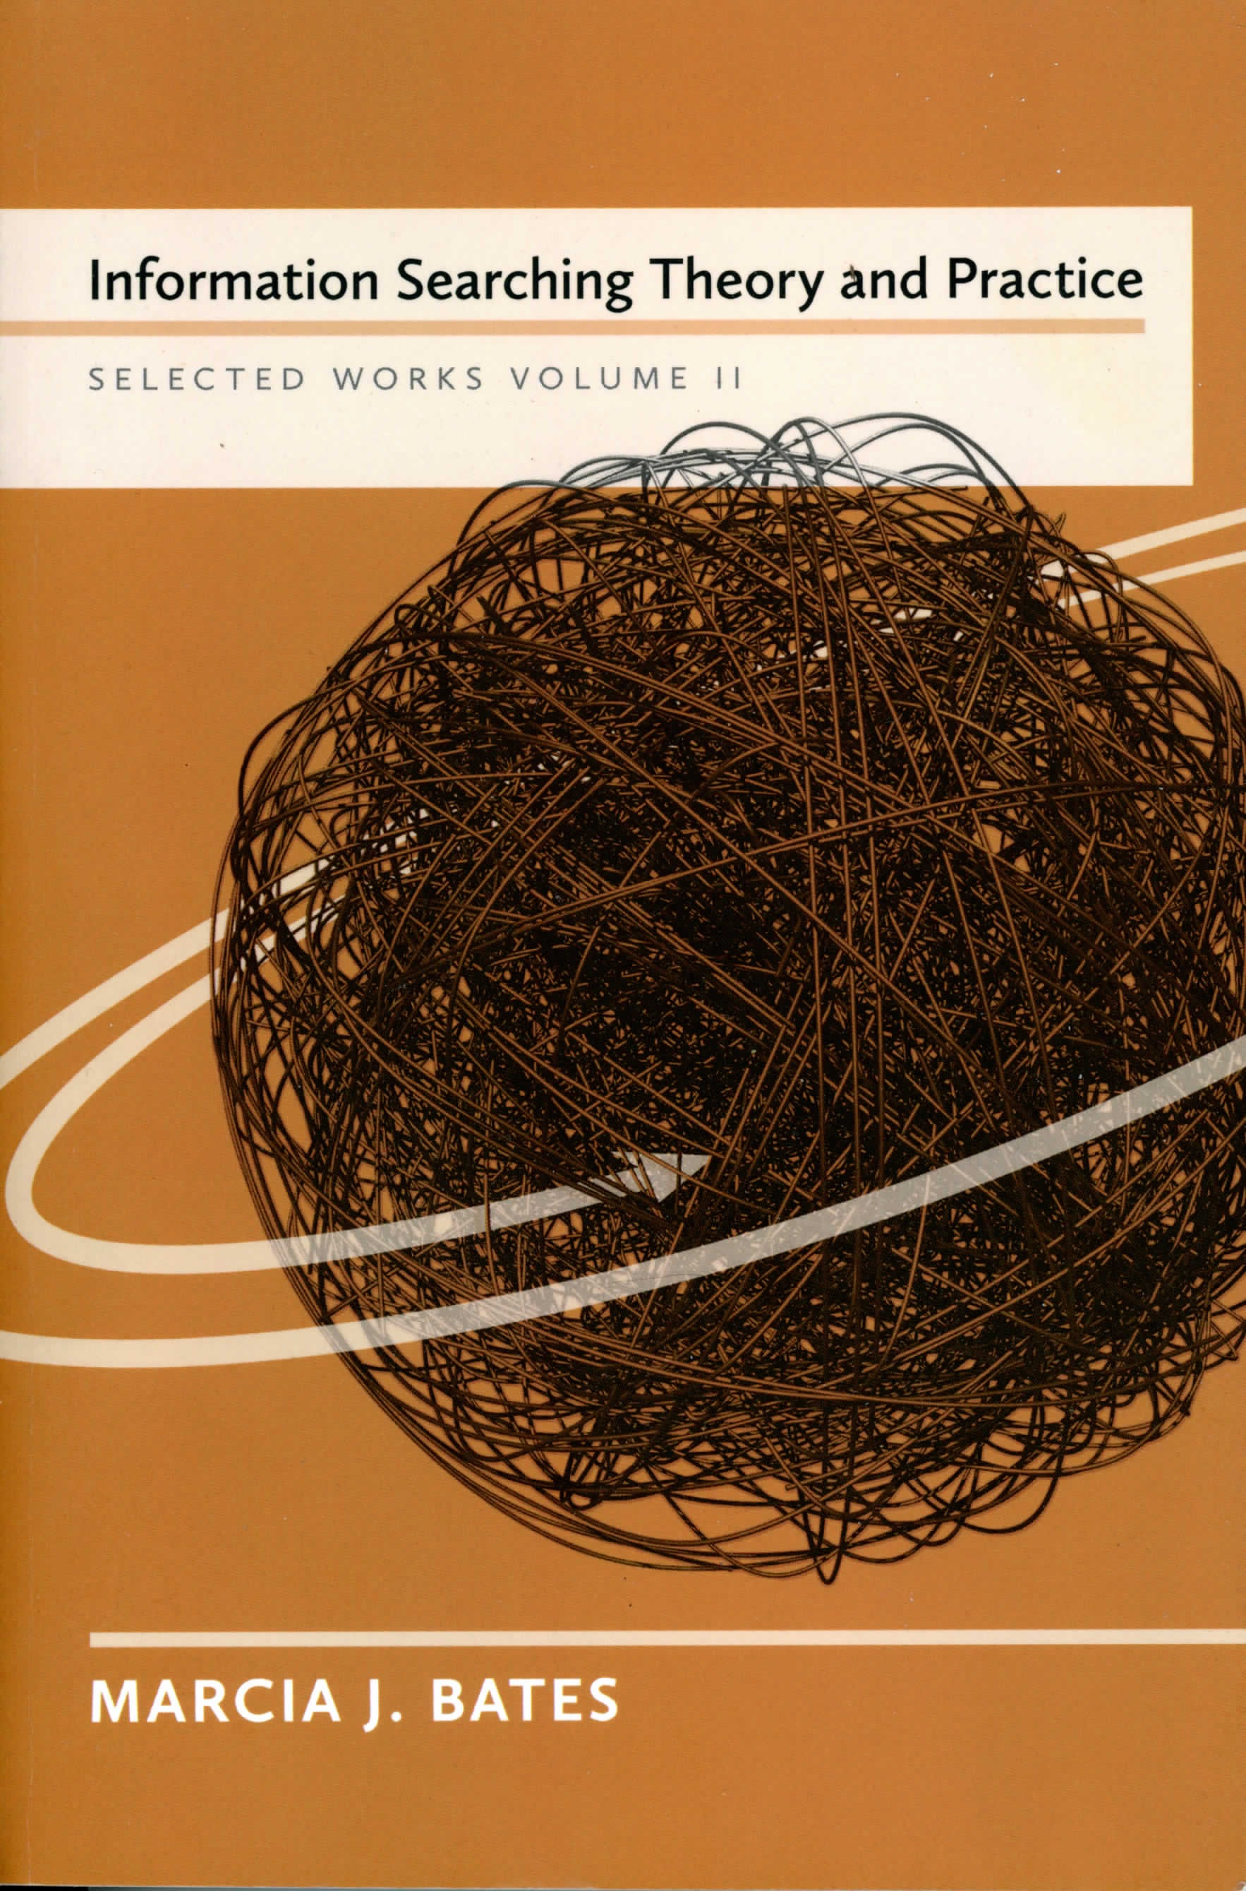

Slide 51
Docking References
Taylor, R. S. (1962) The Process of Asking Questions. American Documentation, 13 (4): 391-396
Belkin, N.J. (1982). ASK for Information Retrieval: Part 1. Background and Theory. Journal of Documentation, 38(2): 61-71.
Bates, M.J. (1986). Subject access in online catalogs: A design model. Journal of the American Society for Information Science, 37(6), 357–376.
Nardi, B. and O'Day, V. (1996). Intelligent agents: What we learned at the library. Libri 46: 59–88.
Kuhlthau, C.C. & Maniotes, L.K. (2015). Guided Inquiry: Learning in the 21st Century. Santa Barbara, CA: ABC-CLIO.

Slide 54
Simple vs. complex questions
Bates, M.J. (2016). Many paths to theory: The creative process in the information sciences. In D.J. Sonnenwald, (Ed.), Theory Development in the Information Sciences (p. 21-49). Austin, TX: University of Texas Press. See pp. 36-38.
OR, also published in:
Bates, M.J. (20126). Information and Information Professions: Selected Works of Marcia J. Bates, volume 1. Berkeley, CA: Ketchikan Press, pp. 243-245.

Slide 55
Matching search method to info density
Bates, Marcia J. (2016). Speculations on browsing,
directed search, and linking in relation to the
Bradford Distribution. In Bates, Marcia J.
Information Searching Theory and Practice:
Selected Works, Vol. II, pp. 279-293. Berkeley, CA:
Ketchikan Press.

Slide 56
SUMMARY OF DESIGN PRINCIPLES
• Make full use of our inborn propensity to browse our
environment and learn through “wallpapering.”
• Design immersive walking-through-life search model in
addition to a desktop command model for information
searching. Optimize browsing potential!
• Design for docking for the 40-45 percent of questions
that are complex and often answered erroneously.
• Design to make it easy to use a variety of search
techniques that each match the actual information
densities in resources.

Slide 58
END OF THE ROAD

