Slide 1
Circulation Audit Bureaus
Information Studies 180: Ecology of Information
Instructor: Dr. John Richardson
October 22, 2008
Ross Moody

Slide 2
What are Circulation Audit Bureaus?
Definition from IFABC: “Industry-sponsored organizations established…to verify and report facts about the circulations of publications and related data (International Federation of Audit Bureaux of Circulations 2008).”
Private, non-profit associations of advertisers and print media publishers
Have purposes for both advertisers and media alike
Act as “CRAs” for advertisers

Slide 3
Circulation Bureau History
Around 1860- publishers beginning to promote their newspapers to and negotiate with advertisers using circulation figures (Moseley 2002).
1899- American Association of Advertisers established- tried to compel publications to furnish statements, give access to auditors’ notes.
By 1900, daily newspaper circulation has passed (allegedly) 15 million; 2,150 daily newspapers operating in U.S (University of Minnesota 2008).
No private compacts or public code governing research, publication of circulation figures.
Consequence: inflated figures, or none at all (Moseley 2002).
Advertisers frustrated --> 1914- Establish the U.S. Audit Bureau of Circulations with help of advertising agents.

Slide 4
Circulation Bureau History (continued)
British follow suit in 1931 (same name), national and international CABs established around the world throughout 20th century, including IFABC in 1963.
Organizations formulated for standardizing Internet measurement throughout late 1990s, incorporated by IFABC.

Slide 5
Verification Process
1) Publisher meets circulation requirements, pays fee (goes to appointment of auditors, in-house services, training).
2) Board elects to issue membership certificate.
3) Publisher undergoes audits; nature of auditor can vary-- can be both in-house and independent
4) Rules of auditing:
Publishers must furnish statements (weekly, monthly, yearly averages, quarterly geographic reports, prices)
Bureau-appointed auditors must have access to all records
Publisher must maintain standards of record storage and reporting frequency
Publisher must maintain subscription, reward practices
Publishers must follow sampling standards for telephone, internet surveys
Info must be confidential
5) CABs examine audit, compare to publisher’s statement--> issue certification or punish.
6) Reward for publishers: easy access to accurate circulation figures of rivals; non-paid associated newspapers attract advertisers.

Slide 6
Organization
Judiciary and Legislative- Mix of members and executives:
Can vote on rules in certain cases
Appointed to undertake investigations
With consent of Board, can take action against paties
Advisory:
Suggest rules to be taken up by Board of Directors
Media advisory and liaison committees
Media “buyer” (individual companies as well as advertisers) advisory and liaison committees
Executive- Board of Directors:
Advertiser divisions
Publisher divisions
Annual democratic elections among members
Hear complaints and appeals
Rule implementation-- can be immediate, conditioned w/ feedback
or voted on by majority of membership

Slide 7
Current Issue: Circulation Decline
2006-2007: Print advertising revenue down 9.4% US (Mullaney 2008); EU- readership down 2.37% (World Association of Newspapers 2008).
Same period-- U.S. newspapers down 2.6% (weekly avg.), 3.5% Sundays nationwide; some “2nd-tier” papers (Boston Herald) down more than 1st-tier (Boston Globe) (Johnson 2008).
Responses by CABs from 2006-2008 (latest annual meeting):
Regional papers (below 50,000 readers) can undergo circulation audits every two years, rather than annually; no geographic requirement
Regional papers can opt out of daily audits, larger papers (between 50-75k) can undergo audits bi-annually w/ conditions
More subscription upgrades
Lack of zip code reporting for national newspapers
Flexibility in effectively offering more ad-space
Digital editions can be included
Total “average” circulation added in reports
However:
Stricter accountability in adding subscriptions
New reader classes added to “verified” circulation for all newspapers
Overall impact: Automatic increase in circulation figures, less-specific figures.

Slide 8
Current Issue: Internet Growth
Internet:
Online readership up 31% in U.S., 2005-2006 (Reuters 2006); UK- Times Online (92% increase), Guardian (46%), Sun (51%) (ABCe 2008).
“Online CABs”: U.S.: Nielsen Online; U.K.- ABCe (both founded 1996); Internet Advertising Bureaus (IAB) worldwide (France, Argentina, etc.).
Software use, direct auditing by Nielsen (using IAB parameters).
Problems:
In 2006- Bots- Responsible for up to 40% of ad impressions; cookie-clearing- Inflation of up to 1000% per month (Internet Advertising Bureau 2006).
Possible globally-based conflict of interest (e.g. FreeRice)
No newspaper publishing companies involved with setting rules
Solutions:
Create bot and spider lists--> create filtering programs to deduct visits

Slide 9
Works Cited
ABCe. August 2008. ABC Multi-platform Report. ABCe. http://www.abce.org.uk/cgi-bin/dmr.cgi?runprog=abce/abce&o=&c=&type=subreports&pfile=Multi_Platform/Multi_Platform_Report_2008-08.pdf&menuid=abce_database|multi&breadcrumbonly (accessed Oct. 14, 2008).
International Federation of Audit Bureaux of Circulations. IFABC home page. IFABC. http;//www.iifabc.org/ (accessed Oct. 13, 2008).
Internet Advertising Bureau. February 6, 2007. IAB And ABCE Announce Global Spiders & Bots List. IAB, http://www.iab.net/about_the_iab/recent_press_releases/press_release_archive/press_release/4924 (accessed Oct. 15, 2008).
Johnson, Carolyn Y. November 6, 2007. Newspaper circulation still on decline. Boston Globe. http://www.boston.com/business/globe/articles/2007/11/06/newspaper_circulation_still_on_decline/ (accessed Oct. 14, 2008).
Mullaney, Tom. March 28, 2008. Newspaper Print Ad Sales Fall 9.4%, Most on Record (Update2). Bloomberg.com, http://www.bloomberg.com/apps/news?pid=20601103&sid=abN6GoHxaz2E (accessed Oct. 13, 2008).
University of Minnesota Media History Project. University of Minnesota Media History Project, 1900-1909. University of Minnesota, http://www.mediahistory.umn.edu/timeline/1900-1909.html (accessed Oct. 15, 2008).
World Association of Newspapers. June 2, 2008. World Press Trends: Newspapers Are a Growth Business. World Association of Newspapers, http://www.wan-press.org/article17377.html (accessed Oct. 14, 2008).

Slide 10
The Survival of Newspapers
Is on-line the only answer?

Slide 11
Issues for Consideration
The definition of a newspaper?
What business are they in?
Everything is finite!
Do people still value physicality? Looking to leaders in the field and other countries for inspiration....

Slide 12
The business of Newspapers
Definitions are important!
A daily or weekly publication consisting of folded unstapled sheets and containing news, articles, and advertisements.
A newspaper is a written publication containing news, information and advertising, usually printed on low-cost paper called newsprint.
Notes:
The point is when is a newspaper no longer a newspaper
Online – becomes a set of internet articles that perhaps have slightly more legitimate sources (maybe not in the future)
Compete against every other information source out there
Have to look at the key differences that can attract the information seeker

Slide 13
US Newspapers
What makes them the same/different??
Tonality
Perceived legitimacy
Size, layout, imagery
Content
????????????

Slide 14
Hungry?
The newspaper Cake
What are the essential ingredients?
What could we add/remove based on the evolving information seekers needs and wants?

Slide 15
Niching
Newspaper is the only medium which generally does not attempt to target a niche...
- Think TV, magazines etc
Some Niche Paper Ideas??
‘Pick and mix’ newspaper
Teen news

Slide 16
Free Newspapers
Where does the majority of newspapers earnings come from?
36 million free papers are distributed daily in 49 countries.
In Spain 51% of newspaper circulation is free.
Spain's 20 Minutos
Pioneer in the free newspaper space in Western Europe
Now Spain’s most distributed newspaper
Is (free) the key reason why the Bruin is successful?
http://www.pbs.org/mediashift/2007/08/free-newspapers-lead-way-online-in-europe229.html

Slide 17
Free Newspapers: MX-Australia
Similar style to USA Today
- Short precise news
Main stream advertising/doesn’t rely on classifieds
Targets a niche
- Time conscious
Young professionals
Use public transport
Aspirational
What can you observe?
- Headlines
- Layout
- Content
- Size

Slide 18
Free Newspapers: MX-Australia
MX says:
mX has tapped into a unique audience of young, time starved individuals who are increasingly difficult to reach using traditional media. - As the only daily commuter newspaper in Australia, it has attracted a loyal readership that is still experiencing growth. mx reaches over 94,250 (CAB Audit Mar 08) people in Sydney, 88,193 (CAB Audit Mar 08) people in Melbourne and 40,000* people in Brisbane every afternoon. - mX provides advertisers with a captive audience as they make their way home. Readers love mX because it satisfies their information needs and gives them an afternoon ‘pick me up’.
http://www.mxnet.com.au/

Slide 19
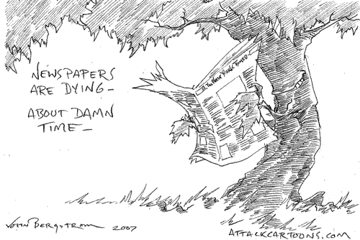
Points of Differentiation
Staying one step ahead without the web
Greening
Convenience
Depth of Content
Price
Information ‘WANTS’ from newspaper readers

Slide 20
My View
Newspapers will survive!
They will never be only on the internet
What they have that the internet doesn't -Physicality and tactility! These are important to human beings
Variety will decline as the industry becomes dominated by only a few players
Must evolve with the changing desires of today's information seeker and the changing information environment

Slide 21
Final Thought - The Future
Globalisation
The forming of one habitat
One currency (Euro), one language and.....
One paper
The Global Paper
‘World Today’
The obvious implication: One View!

Slide 22
Newspaper and the Internet
Alex Garcia

Slide 23
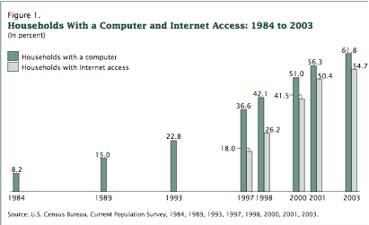
How Available is the Internet?
http://www.census.gov/prod/2005pubs/p23-208.pdf

Slide 24
Internet Devices
Computers/Laptops
Cell Phones
PDA’s
iPods
Gaming Systems (Playstation, Xbox, etc.)

Slide 25
Where Can You Find WiFi?
Households
Schools/Universities
Libraries
Cafes
Business
Hotels

Slide 26
Pretty Much, Everywhere. . .

Slide 27
Useful WiFi Locators
http://www.jiwire.com/
http://www.wififreespot.com/
http://www.wi-fihotspotlist.com/
http://www.wireless.att.com/laptopconnect/wifilocator
http://www.youcanworkfromanywhere.com/wi-fi/

Slide 28
Typical Newspaper Sections
Local/domestic/national news
International news
Business/finance/economy
Politics
Sports
Weather
Classified ads
Interviews
Letters from the readers
Opinion/editorial
Entertainment/comics/crossword puzzle/horoscopes
Arts, culture, literature
Events/movies
Broadcast/cable television guide
Society/people
Tourism/travel tips
Computers
Automobiles
Style/fashion
Cooking/cuisine
Health/medicine
Home & decoration
Family
Kids/youth
Magazines and other supplements
http://www.zonalatina.com/Zldata29.htm

Slide 29
Online Competitors

Slide 30
What Are Newspaper’s Biggest Online Threats?

Slide 31
“Ten million Craigslist users click on an estimated 6.5 million classified postings each month at 190 local sites in 35 countries, generating three billion page views.”
-Adam Lashinsky, FORTUNE senior writer
http://money.cnn.com/2005/12/02/technology/craigslist_fortune_121205/index.htm

Slide 32
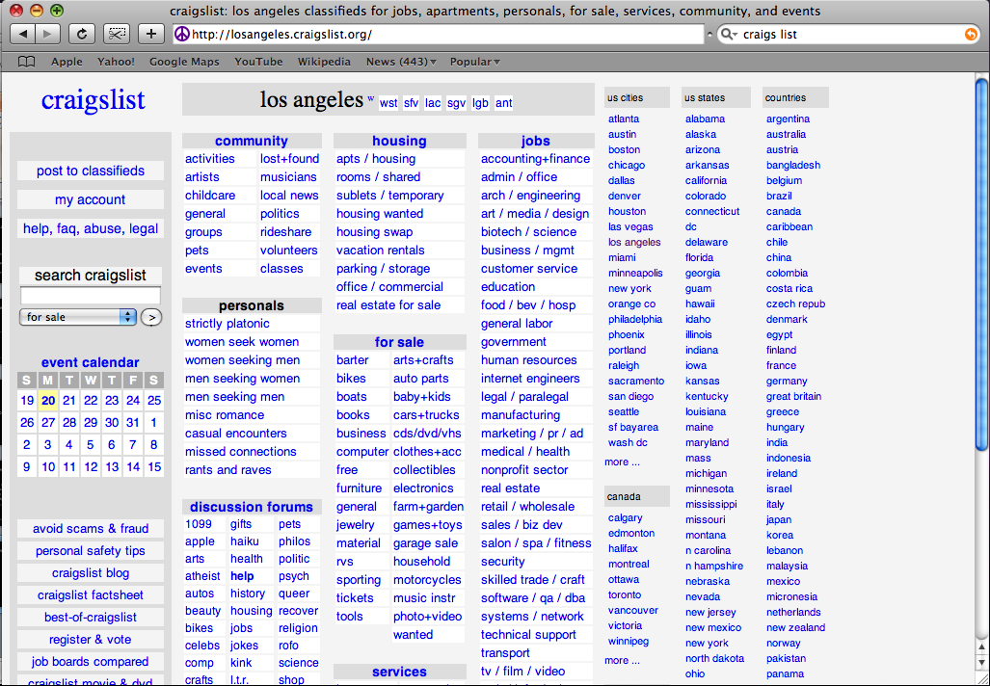
Classifieds

Slide 33
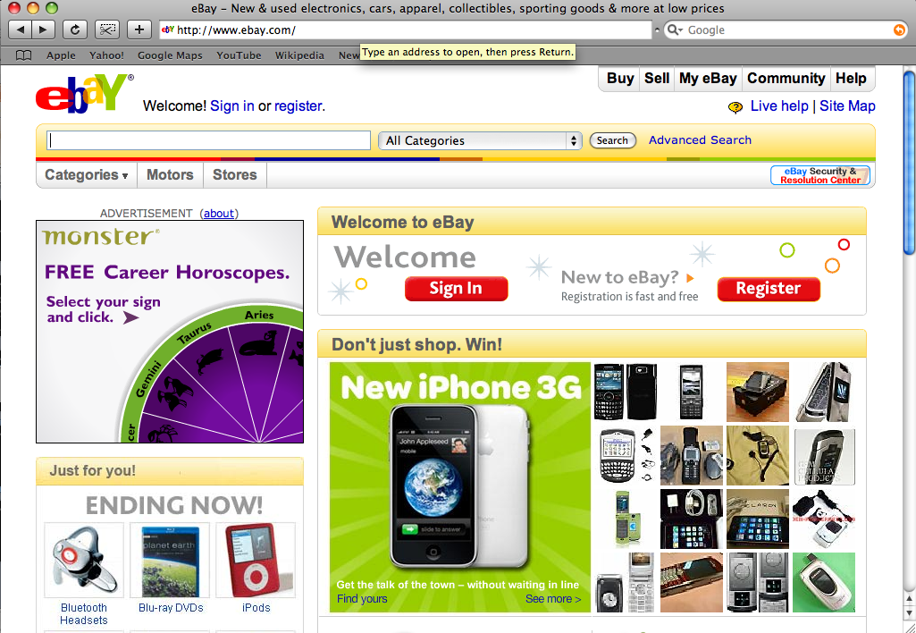
Classifieds

Slide 34
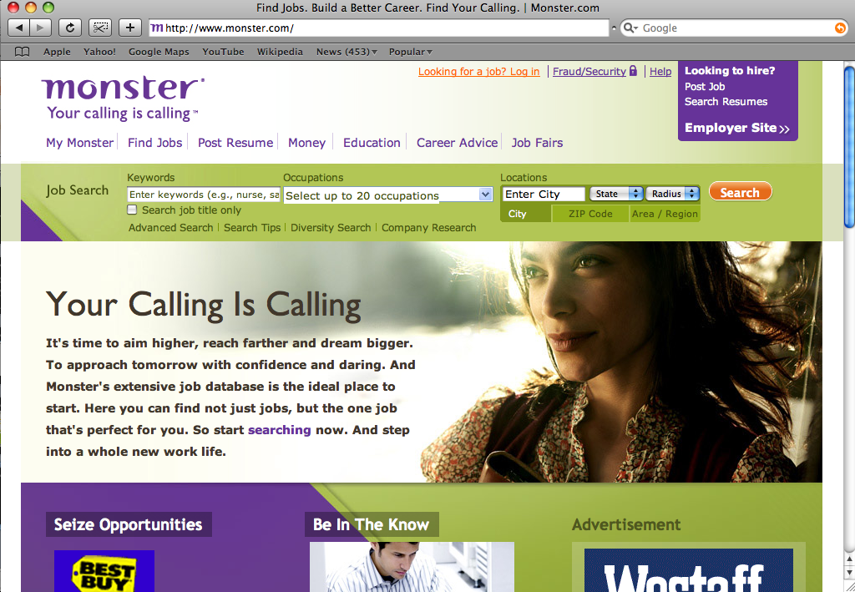
Classifieds

Slide 35
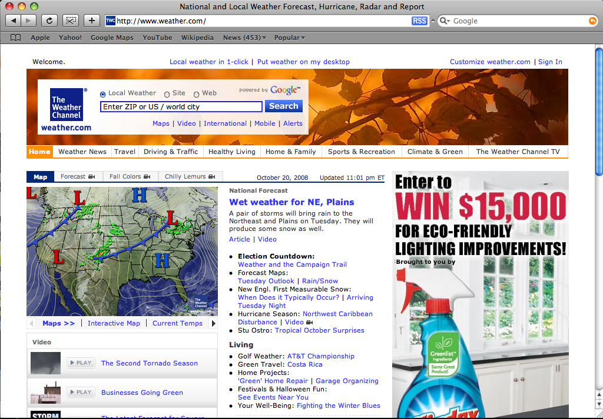
Weather

Slide 36
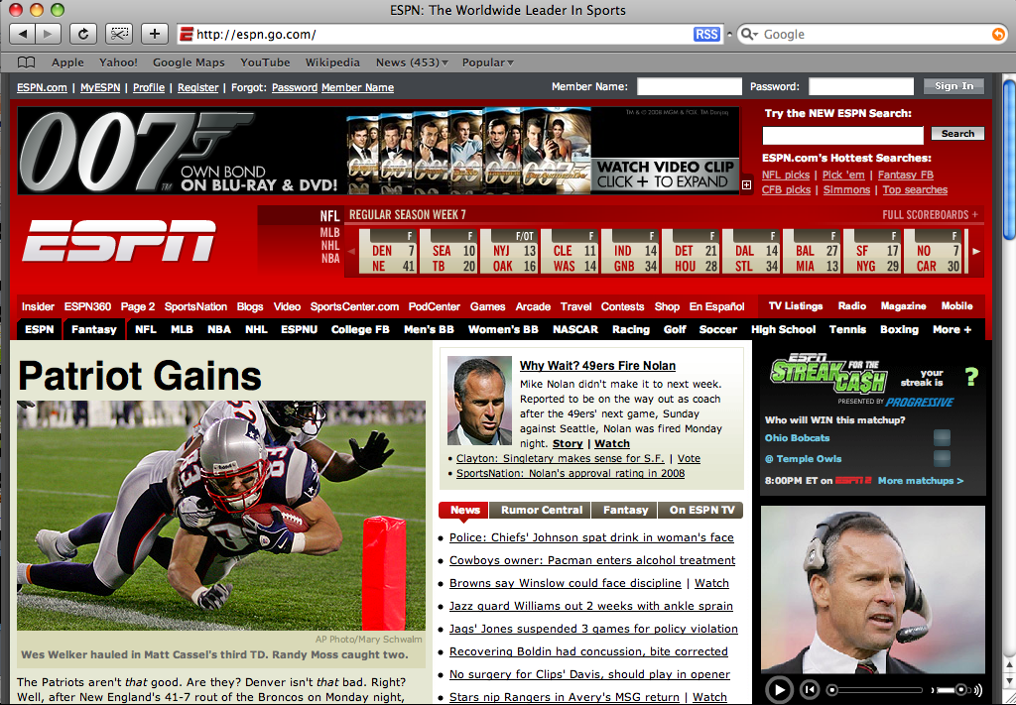
Sports

Slide 37
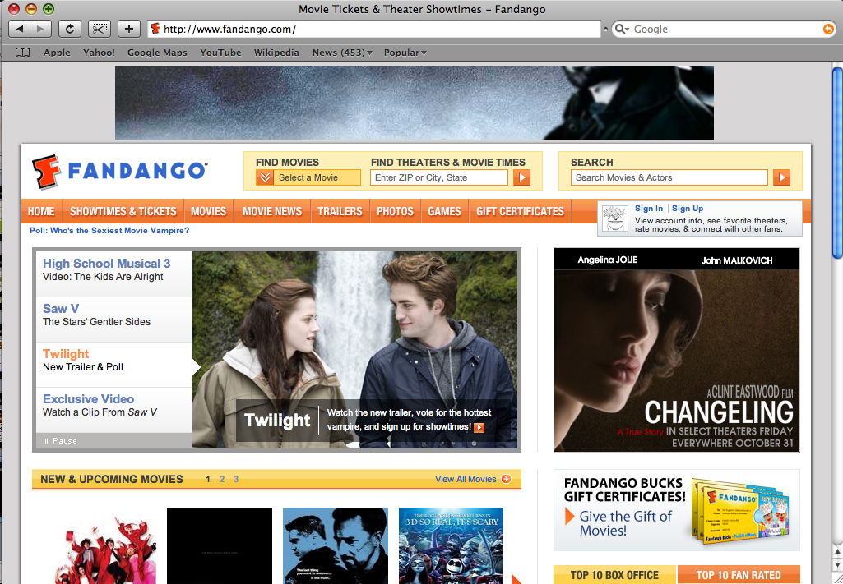
Entertainment

Slide 38
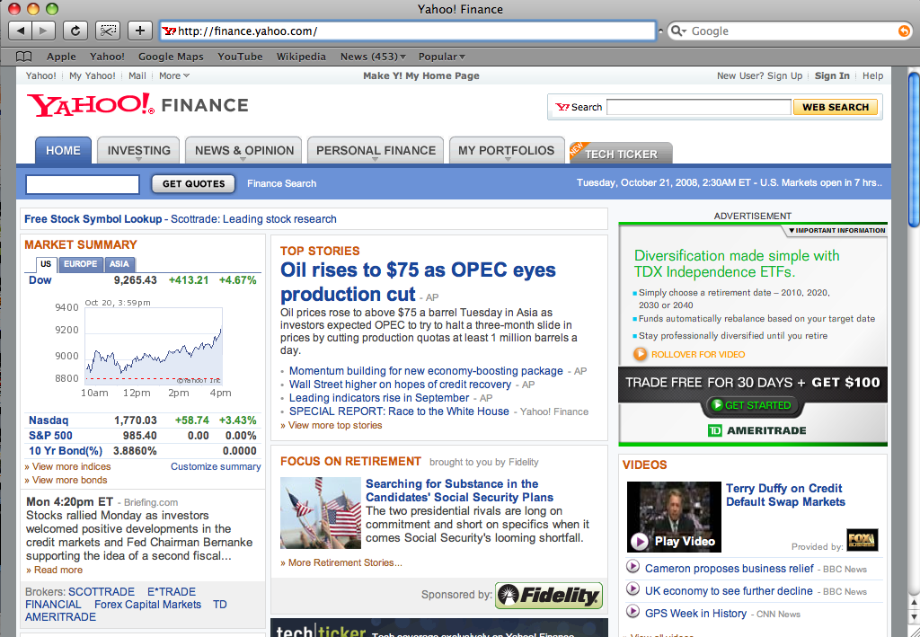
Business/Finance/Economy

Slide 39
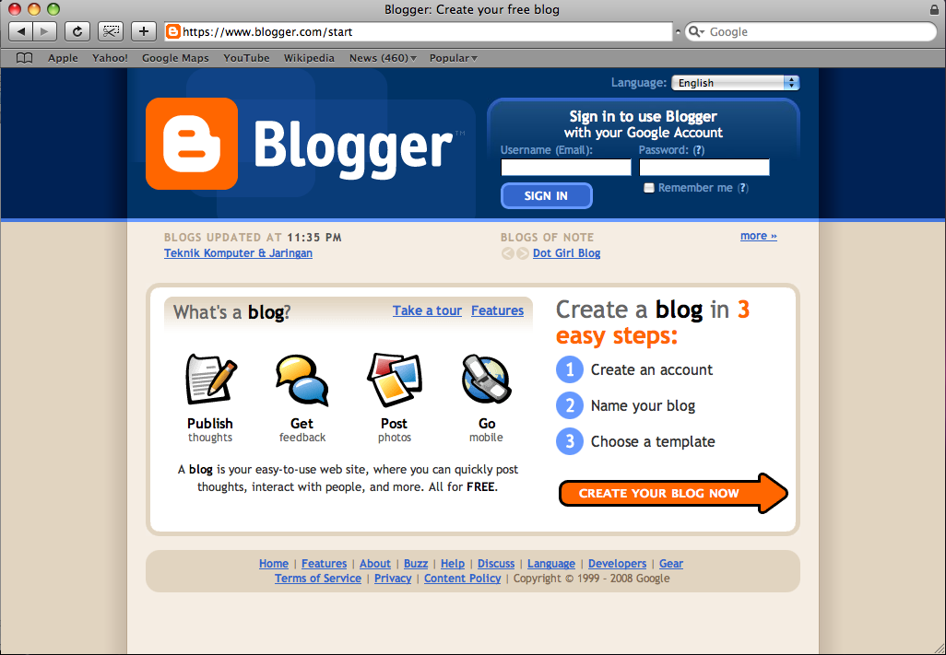
Letters To The Editor

Slide 40
What Newspapers Are Online?

Slide 41
Top 100 U.S. Sites
22. The New York Times
51. Washington Post
78. Wall Street Journal
92. Los Angeles Times
http://www.alexa.com/site/ds/top_sites?cc=US&ts_mode=country&lang=none

Slide 42
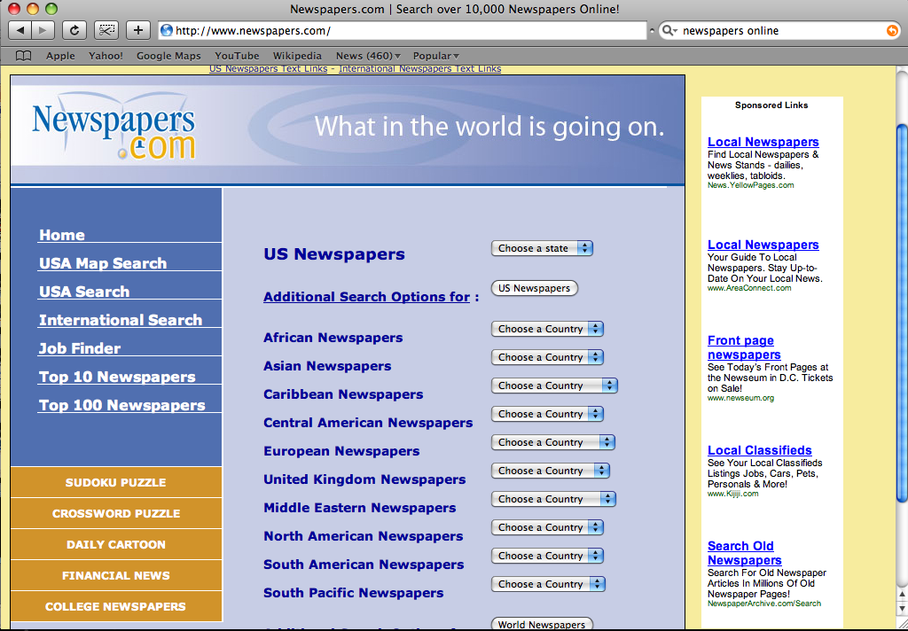
www.Newspapers.com

Slide 43
“The Newspaper Association of America reported the number of unique visitors to newspaper Web sites last year rose more than 6 percent to a monthly average of 60 million. Monthly visits climbed 9 percent in the fourth quarter from a year ago.”
-January 24, 2008
http://www.reuters.com/article/technologyNews/idUSN2424356120080125

Slide 44
What Have Newspapers Done To Keep Up With The Internet World?

Slide 45
“NewspaperDirect Inc. has agreements with 60 newspapers (including this one) to print miniature versions of the full publication on demand in places where regular distribution is not cost effective. Some 80 locations such as hotels and business centers — and even one cruise ship — host the company's computer and printer.”
-Jeanette Borzo
Herald Tribune 2001
http://www.iht.com/articles/2001/06/28/btpub28.php

Slide 46
“Beginning on April 4, The New York Times will stop publishing daily stock listings on Tuesdays through Saturdays and will offer a new package of interactive tools and market information on its Web site. . . Times will join other newspapers that have cut stock listings to reduce newsprint costs as more readers monitor investments using the Internet.”
-Julie Bosman
Herald Tribune 2006
http://www.iht.com/articles/2006/03/14/business/listings.php

Slide 47
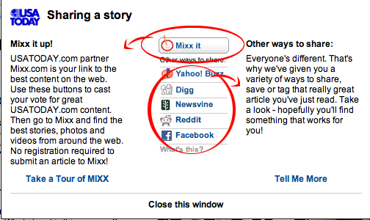
Adjusting to the Fads
Every major newspaper has RSS Feeds.
Many contain links to share news.
www.Mixx.com

Slide 48
New Ideology?
“It's not a website you would turn to for immediate news. Hurricanes, plane crashes, the he-said-she-said of electoral politics just doesn't register on csmonitor.com.”
- Alex Beam
The Boston Globe August 2008
http://www.boston.com/ae/media/articles/2008/08/26/monitoring_the_future_of_newspapers/

Slide 49
Newspaper Next 2.0
“In this report, the American Press Institute’s Newspaper Next project builds on its original work, offering additional strategic concepts and practical guidance to help the industry make the leap beyond ‘newspaper companies’ to a brighter future.”
-American Press Institute
http://www.newspapernext.org/Making_the_Leap.pdf

Slide 50
Interesting Readings
Newspapers: Future
Frank Ahrens, October 12, 2005
http://www.washingtonpost.com/wp-dyn/content/discussion/2005/10/11/DI2005101101387.html
Forum: The Future of Newspapers
Jeremy Caplan, December 6, 2006
http://www.time.com/time/business/article/0,8599,1566014,00.html
A Bright Future For Newspapers
Paul Farhi, June 2005
http://www.ajr.org/article.asp?id=3885

